Slide 1

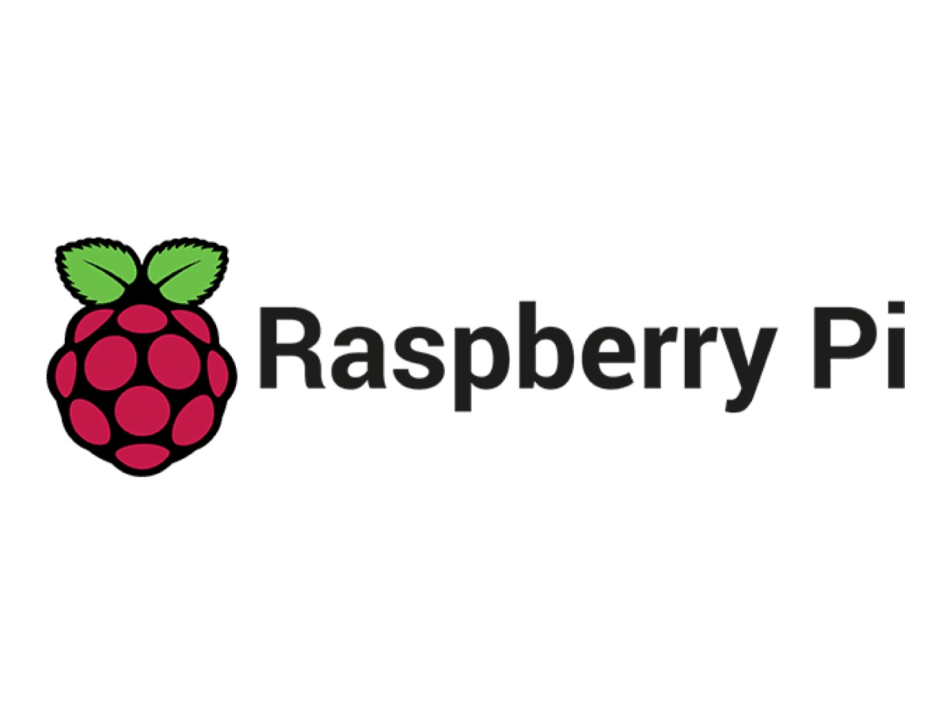
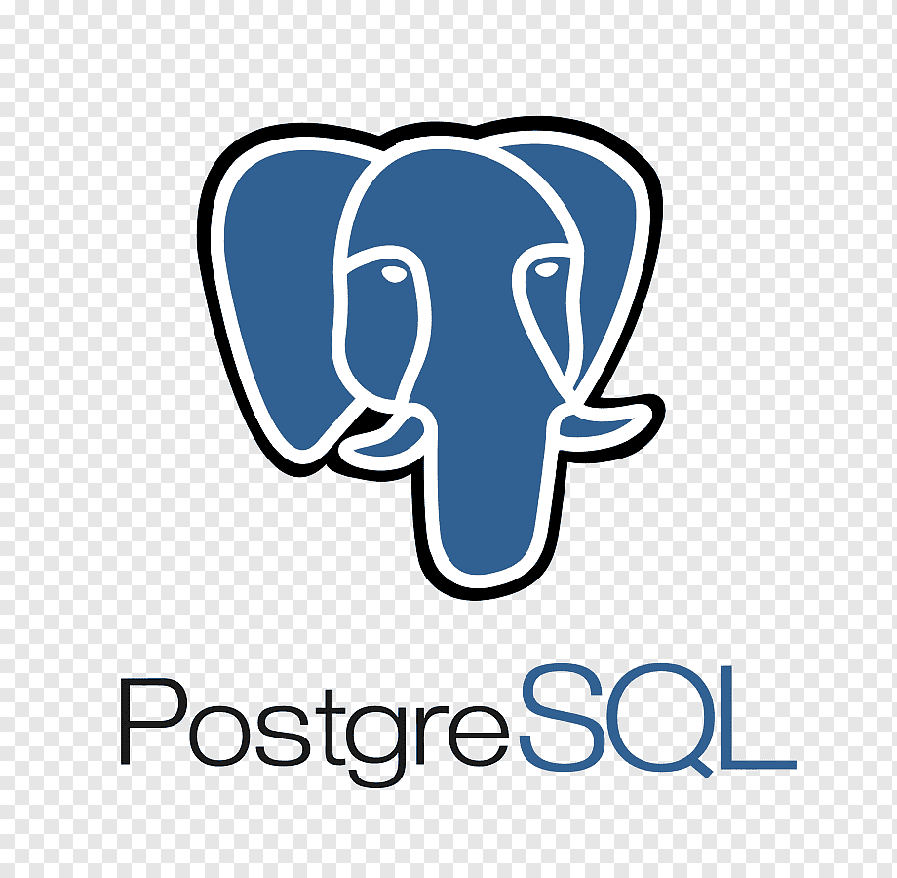

Simulating migration to a new Data Management System
With a Raspberry Pi, Python, SQL
Consultation with ChatGPT and Ned.T.

Slide 2
Why do it this way?
Display skills
Keep it specific
Show what Ive got
Project approach – concrete and good way to learn fast
Excuse to use Raspberry pi

Slide 3
First Stages
Pi -> VM -> SQL database
Host some environmental, financial, and customer data
Move from one system to another

Slide 4
How
SQL server?
Python scripts to handle the migration
Consult with ChatGPT for: - Ideas, code, and rubber ducking
Consult with Ned.T for collaboration, expertise, teamwork practice

Slide 5
Concept/Framework

Slide 6
Hardware Set-up
Raspberry Pi
Excuse to use it again
External / Separate in Space

Slide 7
Software Set-up
Hyper-V manager
Ubuntu22.04 on VM
Python and SQLite to Raspberry pi
PostgreSQL for later

Slide 8
Database creation
Download data
Create db
Upload to SQL

Slide 9
Demo data pull
Some stats?
Pros and cons of SQLite

Slide 10
New DB creation

Slide 11
Migration to New PostgreSQL db

Slide 12
Demo data pull
Pros and cons of PostgreSQL db
Some stats?
Demo data pull plus vis
Encryption of data?

Slide 13
Wrap up
What did we do
Why

